Slide 1


CGL, EBL & Crime Insurance

Slide 2



Objectives
Understand Commercial General Liability Insurance
Understand the role and importance of CGL policy
Study the liability loss exposures faced by businesses
Study the coverages offered under a CGL policy
Study the losses excluded under the policy
Study the limits and rating factors applicable to the coverages
Understand Employer Benefit Liability Insurance
Understand the need for Employer Benefit Liability Insurance
Study about the coverages offered
Understand exclusions who is an insured and the limits
Understand Commercial Crime Insurance
Study the crime related loss exposures arising out of business
Understand the insuring agreements under commercial crime policy
Study the commercial crime limits and deductibles
Study the exclusions under the policy

Slide 3

Commercial General Liability
Provides coverage for the liability arising out of a person’s or an organization’s activities as part of his business
It intends to cover individuals, organizations, companies with partnerships, JVs, LLC etc.
Loss Exposures include:
Premises Liability Exposure
Operations Liability Exposure
Products Liability Exposure
Completed Operations Liability Exposure
Liability
Premises and operations
Products and completed operations
Personal and advertising injury
- Acts of negligence
Libel
Slander
Wrongful eviction
- Bodily injury
- Physical damage

Slide 4
Commercial General Liability contd…
Coverages
Coverage A - Bodily Injury and Property Damage Liability
Insures against claims arising out of premises, operations, products, completed operations and contractual liability exposures
Covers bodily injury, sickness or disease sustained by a person, including death, pain and suffering
Covers physical injury to tangible property, including loss of use, and loss of use of the property that is not damaged
To be insured the bodily injury or the property damage must be caused by a single occurrence
The loss must have occurred in the coverage territory which includes United States, Puerto Rico and Canada
Insurer’s duty to defend are broader than it’s duty to pay damages
Coverage B - Personal and Advertising Injury Liability
Insures against claims based on torts such as libel, slander, wrongful eviction etc.
Also protects against claims of oral or written publications and copyright infringement
The coverage territory is worldwide for coverage B
Insurer also defends the insured if the insured is held legally liable
Coverage C - Medical Payments
Covers for medical expenses including funeral expenses for bodily injury caused by an accident on premises owned or rented by the insured, including the ways adjacent to such premises (also from operations away from the premises)
The expenses must have incurred and reported within one year after the date of the accident
Coverage is provided despite liability

Slide 5
Commercial General Liability contd…
Exclusions:
Coverage A – Exclusions
Expected or intended injury
Contractual liability
Liquor liability
Pollution
Aircraft, Auto or Watercraft
War
Mobile equipment
Personal and advertising injury
Electronic data
Coverage B – Exclusions
Criminal acts
Knowing violation of rights of others
Material published with knowledge of falsity
Electronic chatroom or bulletin boards
Coverage C – Exclusions
Any insured
Anyone hired to work for the insured
A person entitled for worker’s compensation benefits
Common exclusions are intended injury, contractual liability, liquor liability, war, pollution etc.

Slide 6
Commercial General Liability contd…
CGL policy also provides supplementary payments
Fees for attorneys
Cost of bail bonds
Loss of earnings
Interest on judgements
Endorsements can be included to enhance the limits of supplementary payments, watercraft coverage etc.
Per occurrence limit specifies the maximum amount per occurrence. Sub-limits include Damage to premises rented to you (basic $ 100,000) and Medical expense limit for one person (basic $ 5,000)
CGL coverage form has two limits along with a limit for each covered occurrence. These cap the amount to be paid for the entire policy period
General aggregate limit – Maximum the insurer will pay for the sum of damages under Cov A (except those arising from products-completed operations), Cov B and Cov C
Products-completed operations aggregate limit – Maximum the insurer will pay in Cov A for bodily injury or property damage arising out of products-completed operations hazard

Slide 7
Commercial General Liability contd…
Personal and advertising injury limit
General
Aggregate
Limit
Occurrence limit
Damage to premises rented by
you
Medical expense limit
Products- Completed Operations Aggregate Limit
Each occurrence limit

Slide 8
Commercial General Liability contd…
Determining rates of a CGL policy
Separate rates may be determined for premises-operations and products-completed operations
Factors affecting CGL insurance premium include:
Business classification – Primary operations, construction, region, safety, number of employees etc.
Limits of insurance
Coverages
Deductible

Slide 9
Employer Benefit Liability
Provides coverage to the insured (employer) for liability to employees for work-related bodily injury or disease, other than liability imposed on the insured by a workers compensation law. It also includes wrongful death, damages for care or loss of services, consequential injury to spouse, child etc.
EBL pays for the losses or damages only when the insured is held liable and is not a “no fault” coverage
EBL is usually the second part of the Worker’s Compensation policy and covers three broad categories of losses:
Third party over actions - Another party that was held liable for your employee’s injury files this kind of lawsuit against your business. For example, you own a small construction Business. One of your employees was injured using a piece of machinery that you had not properly maintained. The employee sues the manufacturer of the equipment, and the manufacturer turns around and sues you for contributory negligence
Loss of consortium - An injured employee’s spouse files this type of lawsuit. They sue your business because their spouse is no longer able to “engage” in marital relations after their work injury
Dual-capacity suits - An employee can file this type of lawsuit against their employer when a product the employer manufactures is the cause of their injury. That means you would be liable as both an employer and as a manufacturer
Consequential bodily injury - If your employee’s family members suffer bodily injuries as a consequence of the employee’s injury, they could sue your business. For example, say your roofer’s wife suffered an aneurysm from high blood pressure / stress after he fell off a roof and became paralyzed. She could sue you for medical damages

Slide 10
Employer Benefit Liability contd…
EBL coverage form has three important sections:
Section I – Coverage
Section II – Who is an insured
Section III – Limits of insurance
Section I – Coverage:
Payment for work-related bodily injury or disease other than liability imposed on the insured by a workers compensation law for which the insured is legally liable
Supplementary payments without reduction of limits for
Cost of bonds to release attachments
All reasonable expenses incurred by the "insured" at insurer’s request
All interest on the full amount of any judgment that accrues after entry of the judgment
Loss of earnings up to $250 a day
Exclusions:
Civil or criminal liability - failure by the insured to comply with any federal or state statutory or regulatory
reporting requirement relating to an "employer benefits program“
Bodily injury (non work related), property damage, personal and advertising injury
Any dishonest, fraudulent, criminal or malicious act

Slide 11

Employer Benefit Liability contd…
Section II – Who is an Insured
You and your spouse are insureds, but only with respect to the conduct of your business of which you are the sole owner
Members, your partners, and their spouses are also insureds, but only with respect to the conduct of your business
Your employees
Your legal representative, in case of your death
Any organization that you acquire
Section III – Limits of Insurance
Employee Benefits Liability Aggregate Limit is the most we will pay for all "damages" to which this insurance applies
Each Claim Limit is the most we will pay for all "damages" with respect to any one claim

Slide 12
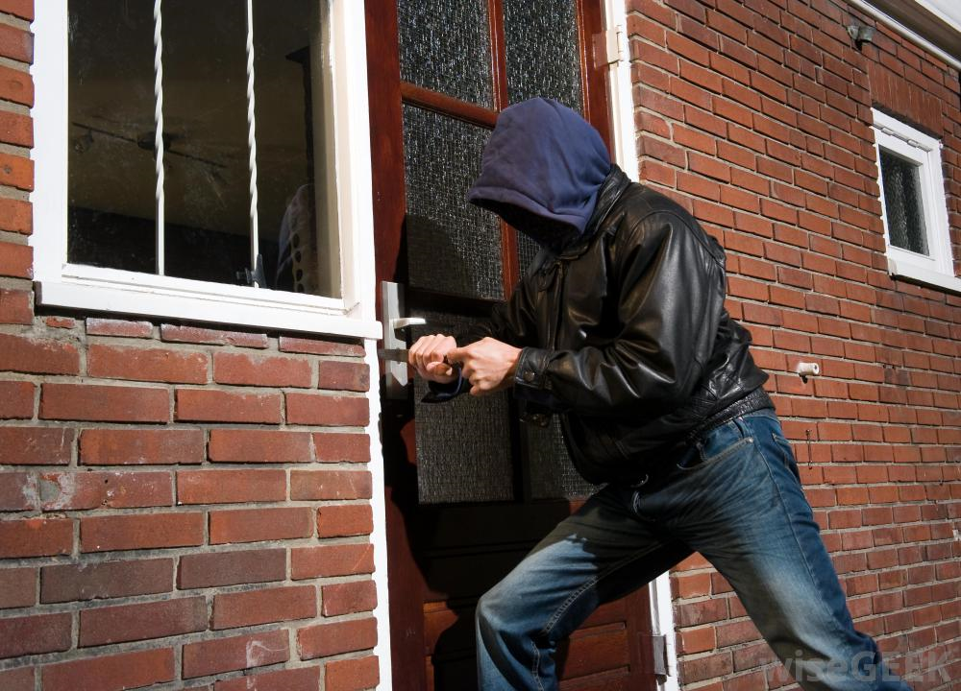
Crime Insurance
Insurance that provides coverage against crime by employees or external entities to protect businesses against financial Loss. It includes the following:
Money and securities against numerous perils
Property other than money and securities against crime perils such as employee theft, robbery, theft by outsiders and extortion
An organization’s property is exposure to numerous crime related loss exposures:
Robbery
Burglary
Forgery
Credit card fraud
Computer fraud
It is issued in two forms:
Discovery Form: Covers losses discovered during policy period even though they may have occurred before the policy period
Loss Sustained Form: Covers losses actually sustained during the policy period and discovered no later than one year after policy expiration

Slide 13
Crime Insurance contd…
The insuring agreements include:
Employee theft - “Theft” of “money”, “securities” and “other property” committed by an “employee” in the territory of US or temporarily outside for 90 days “Forgery” by an employee is also covered
Forgery or alteration - “Forgery” and alteration of checks, drafts etc. drawn by the insured or his agent anywhere in the world. Forgery by an employee is excluded
Inside the premises – Theft of money and securities: “Theft”, disappearance or destruction of money & securities, damage to the premises, damage or loss to locked safe, vaults because of the thief’s presence inside the premises
Inside the premises – Robbery or Safe burglary of other property - Loss due to actual or attempted “robbery” of a “custodian” to other tangible property inside the premises, damages to the locked safe, vaults inside the premises and also the damage to the premises
Outside the premises - “Theft”, disappearance & destruction of “money” and “securities” and actual or attempted “robbery” of “other property” outside the premises under the custody of a messenger or an armored car inside the territories of the US
Computer and funds transfer fraud - Usage of computer to fraudulently cause a transfer of “money”, “securities” and “other property” and fraudulent instruction directing the financial institution to debit “money” and “securities” from the insured’s account anywhere in the world
Money orders and counterfeit money - Acceptance of money orders, counterfeit money under good-faith within the territory of the US

Slide 14
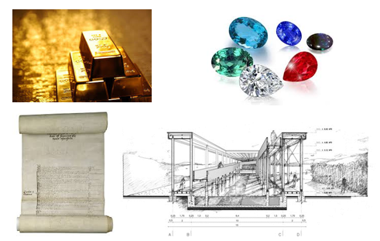
Crime Insurance contd…
Limits
Separate limits may apply for each insuring agreement. If a loss is covered inn more than one insuring agreement, the insurer will pay no more than the highest limit of the insuring agreements that apply
An “occurrence” includes an individual act, the combined total of all separate acts or a series of acts
Payment is made per occurrence basis
Special limits of insurance is provided for :
Precious metals, stone, pearls furs
Manuscripts, drawings or records
Inside the premises – robbery and safe burglary of other property - $ 5,000 per occurrence for 1 and 2
Outside the premises - $ 5,000 per occurrence for 1 and 2
Computer and funds transfer fraud coverage - $ 5,000 per occurrence for 2
Deductible
Loss will be paid only for the amount in excess of deductible

Slide 15
Crime Insurance contd…
Exclusions
General Exclusions
Acts committed by you, your partners and members – Excludes theft or dishonest act committed by named insured, his partners or members whether acting in collusion or with other members
Acts committed known to you prior to the policy period – Excludes if the act by the employee was known to named insured his partner/members prior to the policy effective date
Indirect losses – Excludes losses of e.g. business income loss, liability payments, expense to establish the amount of loss
Government action – Excludes loss from the seizure or destruction of property by order of government authority
Nuclear hazard – Excludes losses by nuclear reaction, radiation or radioactive contamination
Pollution – Excludes the discharge, dispersal, seepage, migration, release or escape solid, liquid or gaseous contaminant
War and military action
Employee Theft
Inventory shortages – Excludes loss that depends on inventory or profit-and-loss calculations to prove either the existence or the amount of loss
Trading – Excludes an employee’s unauthorized trading in stocks, bonds etc. from the named insured’s account
Warehouse receipts – Excludes loss resulting from an employee’s fraudulent or dishonest signing or issuing a warehouse receipt
Inside and Outside the Premises
Arithmetic errors and omissions – Excludes loss resulting from arithmetic errors and omissions
Fire – Excludes loss caused by fire despite its cause. Although loss by fire to safe or vault is covered
Motor vehicles or equipment – Excludes loss caused to motor vehicles or equipment which is better covered under BACF
Vandalism – Excludes loss caused by an act of vandalism or malicious mischief
Computer and Funds Transfer Fraud
Authorized access, fraudulent instructions and credit card transactions

Slide 16
Thank You

